Slide 1
Selenium - Training

Slide 2
What is Selenium
Selenium is a free (open source) automated testing suite for web applications across different browsers and platforms. It is quite similar to HP Quick Test Pro (QTP now UFT) only that Selenium focuses on automating web-based applications. Testing done using Selenium tool is usually referred as Selenium Testing.
Selenium has four components.
Selenium Integrated Development Environment (IDE)
Selenium Remote Control (RC)
WebDriver
Selenium Grid

Slide 3
Story of Selenium
Jason Huggins from ThoughtWorks created a JavaScript program in 2004 to test a web application which automatically control browser’s actions. This is called as JavaScriptTestRunner. Later he mad this tool as Open source on and renamed as Selenium Core which was used to test other web applications.
Reason to go for Selenium RC : Same Origin Policy Issue
What is Same Origin Policy:
JavaScript code which is used to access elements from One Domain cannot be used to access the elements from other domain. – This is called Same Origin Policy Issue. This was the major limitation of using Selenium Core to test any web applications.
So the Selenium Core users must install local copies of both Selenium Core and the web server containing the web application being tested to make sure that both are from same domain.

Slide 4
Story of Selenium continues..
Selenium Remote Control (Selenium RC)
Paul Hammant an engineer from ThoughtWorks had decided to create a server that will act as an HTTP proxy to "trick" the browser into believing that Selenium Core and the web application being tested come from the same domain. This system is called as Selenium Remote Control or Selenium 1.
Languages Supported By RC-2.25.0 : Java,C#,PHP,Python,Perrl & Ruby
Web Driver :
Another engineer called Simon Stewart from ThoughtWorks created WebDriver in 2006 when browsers and web applications were becoming more powerful and more restrictive with JavaScript programs like Selenium Core. It was the first cross-platform testing framework that could control the browser from the OS level.
Selenium 2
In 2008, WebDriver and Selenium RC were merged to form Selenium 2 which is a very powerful tool.
Languages Supported By Web Driver 2 : Java,C#,PHP,Python,Perrl & Ruby

Slide 5
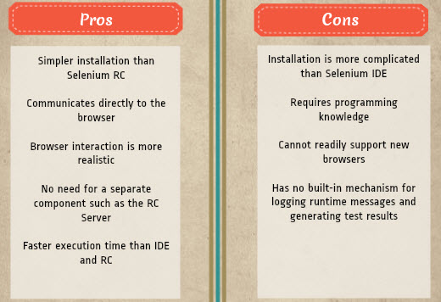
Story of Selenium continues..
Web Driver Continues..
WebDriver allows test scripts to communicate directly to the browser and controlling it from the OS level.

Slide 6
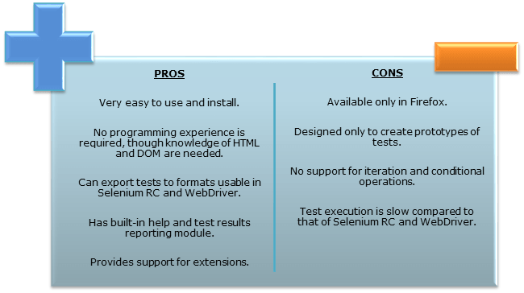
Story of Selenium continues..
Selenium IDE
Selenium Integrated Development Environment (IDE) is the simplest framework in the Selenium suite
It is a Firefox plugin that can be easily installed like other plugins.
Selenium IDE should only be used as a prototyping tool and cannot design/develop advanced test cases.

Slide 7
Story of Selenium continues..
Selenium GRID
Selenium Grid is a tool to run parallel tests across different machines and different browsers all at the same time. Parallel execution means running multiple tests at once.
Features:
Enables simultaneous running of tests in multiple browsers and environments which saves time enormously.
Utilizes the hub-and-nodes concept. The hub acts as a central source of Selenium commands to each node connected to it.

Slide 8
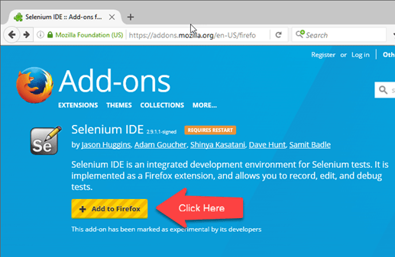
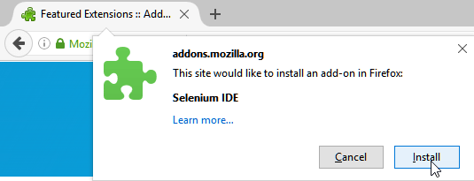
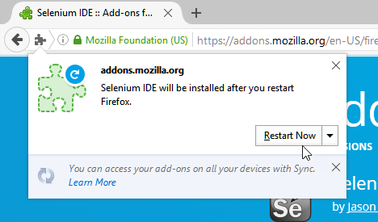
Install FireFox & Selenium IDE
Mozilla Firefox can be downloaded from http://www.mozilla.org/en-US/firefox/new.
Launch Firefox and navigate to https://addons.mozilla.org/en-US/firefox/addon/selenium-ide/. Click on Add to Firefox
Follow any one of the below method to open IDE
By pressing Ctrl+Alt+S
By clicking on the Firefox menu button> Developer>Selenium IDE

Slide 9
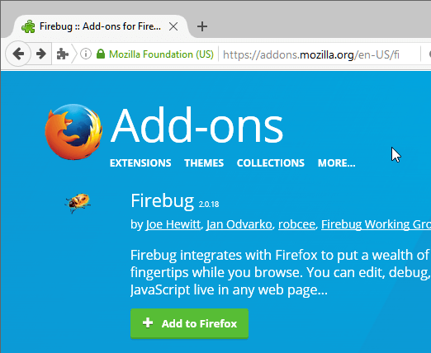
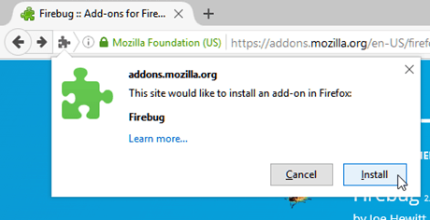
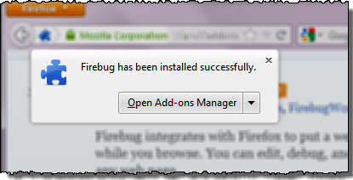
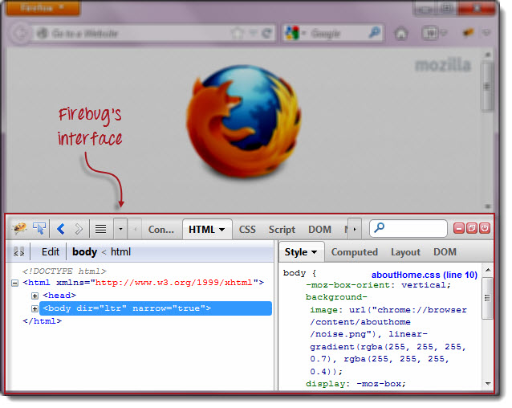
InstallFireBug
Firebug is a Firefox add-on that we will use to inspect the HTML elements of the web application under test.
Use Firefox to navigate to Firebug's download page ( https://addons.mozilla.org/en-US/firefox/addon/firebug/) and click on the download link.

Slide 10
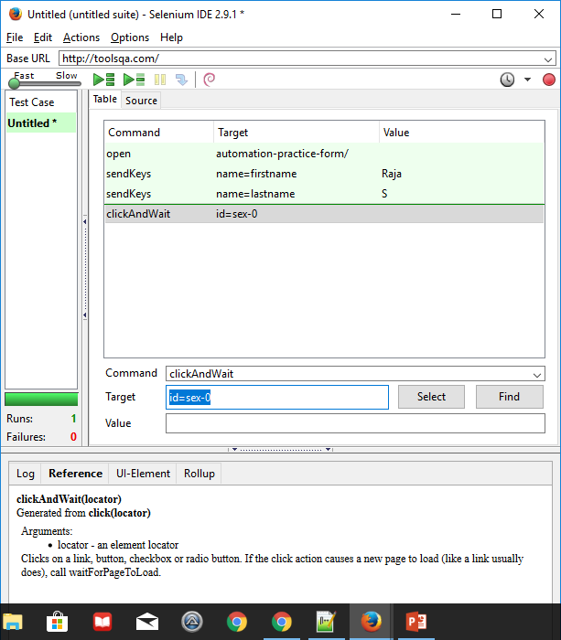
First Script in IDE

Slide 11
Maven
Apache Maven is a software project management and comprehension tool. Based on the concept of a project object model (POM), Maven can manage a project's build, reporting and documentation from a central piece of information. Using maven we can build and manage any Java based project. This tutorial will teach you how to use Maven in your day-to-day life of any project development using Java
POM.xml
Maven project structure and contents are declared in an xml file, pom.xml, referred as Project Object Model (POM), which is the fundamental unit of the entire Maven system
Maven Build Lifecycle
A Build Lifecycle is a well-defined sequence of phases, which define the order in which the goals are to be executed. Here phase represents a stage in life cycle. As an example, a typical Maven Build Lifecycle consists of the following sequence of phases.
Phase | Handles | Description
prepare-resources | resource copying | Resource copying can be customized in this phase.
validate | Validating the information | Validates if the project is correct and if all necessary information is available.

Slide 12
Maven continues..
Phase | Handles | Description
compile | compilation | Source code compilation is done in this phase.
Test | Testing | Tests the compiled source code suitable for testing framework.
package | packaging | This phase creates the JAR/WAR package as mentioned in the packaging in POM.xml.
install | installation | This phase installs the package in local/remote maven repository.
Deploy | Deploying | Copies the final package to the remote repository.

Slide 13
Maven – Example POM.xml
<project xmlns = "http://maven.apache.org/POM/4.0.0"
xmlns:xsi = "http://www.w3.org/2001/XMLSchema-instance"
xsi:schemaLocation = "http://maven.apache.org/POM/4.0.0
http://maven.apache.org/xsd/maven-4.0.0.xsd">
<modelVersion>4.0.0</modelVersion>
<groupId>com.companyname.project-group</groupId>
<artifactId>project</artifactId>
<version>1.0</version>
</project>
Sr.No. | Node & Description
1 | Project root This is project root tag. You need to specify the basic schema settings such as apache schema and w3.org specification.
2 | Model version Model version should be 4.0.0.
3 | groupId This is an Id of project's group. This is generally unique amongst an organization or a project. For example, a banking group com.company.bank has all bank related projects.
4 | artifactId This is an Id of the project. This is generally name of the project. For example, consumer-banking. Along with the groupId, the artifactId defines the artifact's location within the repository.
5 | version This is the version of the project. Along with the groupId, It is used within an artifact's repository to separate versions from each other. For example − com.company.bank:consumer-banking:1.0 com.company.bank:consumer-banking:1.1.

Slide 14
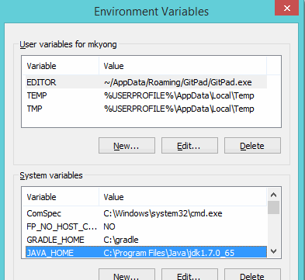
Maven – Installation
To install Apache Maven on Windows, you just need to download the Maven’s zip file, and Unzip it to the directory you wish to install, and configure the Windows environment variables.
Tools Used :
JDK <1.7 or 1.8>
Maven <3.2.2>
Windows <version>
Note Maven 3.2 requires JDK 1.6 or above, while Maven 3.0/3.1 requires
JDK 1.5 or above
Step 1. JDK and JAVA_HOME
Make sure JDK is installed, and “JAVA_HOME” variable
is added as Windows environment variable.

Slide 15
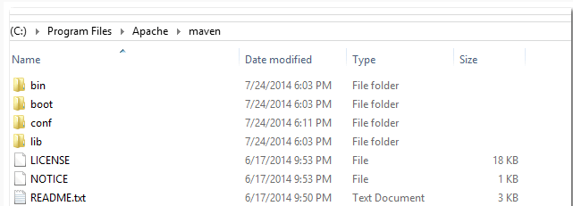
Maven – Installation continues..
Step 2. Download Apache Maven
Visit Maven official website, download the Maven zip file, for example : apache-maven-3.2.2-bin.zip. Unzip it to the folder you want to install Maven.Assume you unzip to this folder – C:\Program Files\Apache\maven
Note : Installation is NOT required.

Slide 16
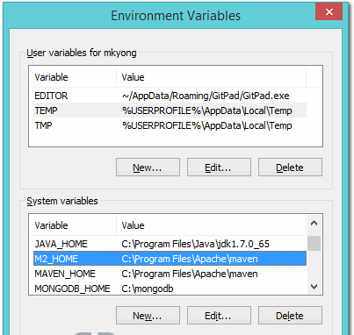
Maven – Installation continues..
3. Add M2_HOME and MAVEN_HOME
Add both M2_HOME and MAVEN_HOME variables in the Windows environment, and point it to your Maven folder.
M2_HOME or MAVEN_HOME Maven document said add M2_HOME only, but some programs still reference Maven folder with MAVEN_HOME, so, it’s safer to add both.

Slide 17
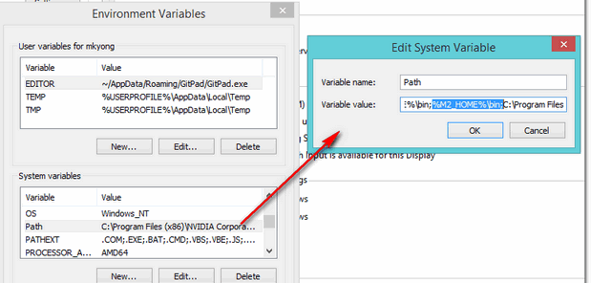
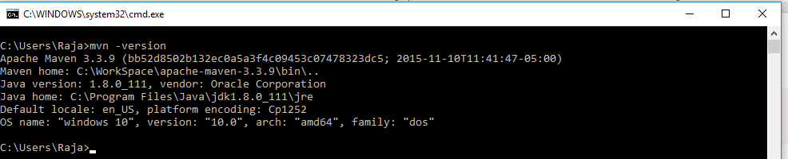
Maven – Installation continues..
Step 4. Add To PATH
Update PATH variable, append Maven bin folder – %M2_HOME%\bin, so that you can run the Maven’s command everywhere.
Step 5. Verification
Done, to verify it, run mvn –version in the command prompt.

Slide 18
TestNG
TestNG is a Testing framework that overcomes the limitations of another popular testing framework called JUnit. The "NG" means "Next Generation.
Advantages of TestNG over JUnit
There are three major advantages of TestNG over JUnit:
Annotations are easier to understand
Test cases can be grouped more easily
Parallel testing is possible
Why do we need TestNG in Selenium?
TestNG can generate reports based on our Selenium test results.
WebDriver has no native mechanism for generating reports.
TestNG can generate the report in a readable format like the one shown below.
There is no more need for a static main method in our tests. The sequence of actions is regulated by easy-to-understand annotations that do not require methods to be static.
Uncaught exceptions are automatically handled by TestNG without terminating the test prematurely. These exceptions are reported as failed steps in the report.

Slide 19
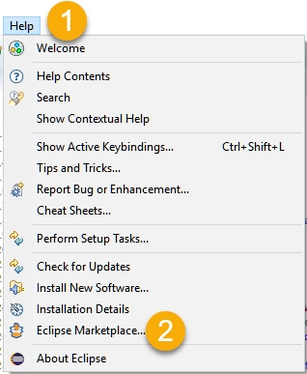
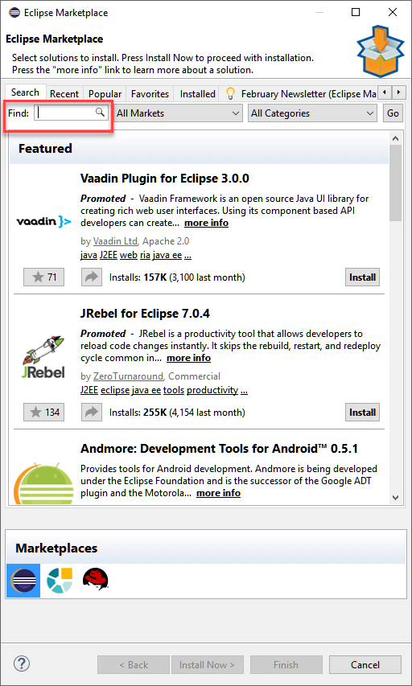
TestNG – Installation
Step 1:
Launch Eclipse.
On the menu bar, click Help.
Choose the "Eclipse Marketplace..." option.
Step 2: In the Eclipse Marketplace dialog box, type TestNG in the search box and press the search button( magnifying glass) or press enter key

Slide 20
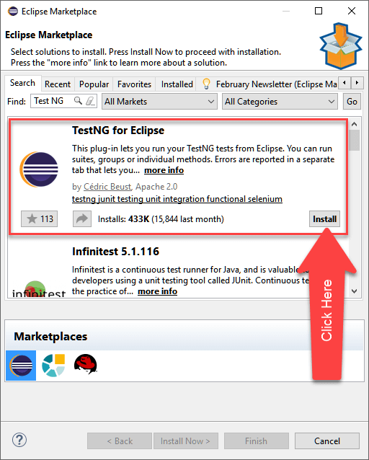
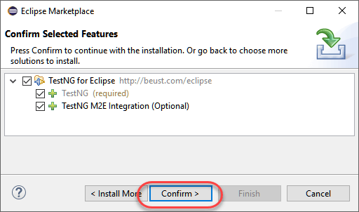
TestNG – Installation
Step 3: Click Install
Step 4: A new window for feature selection will open, Do not change anything and Click on confirm button

Slide 21
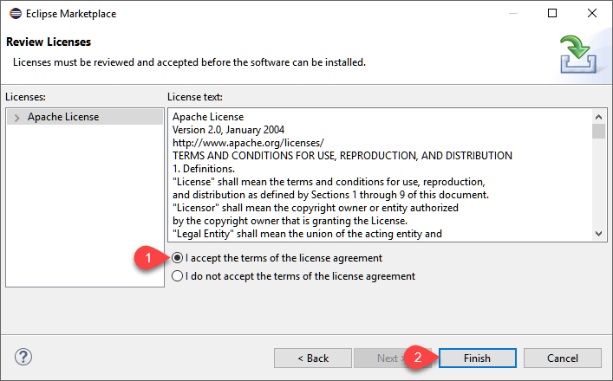
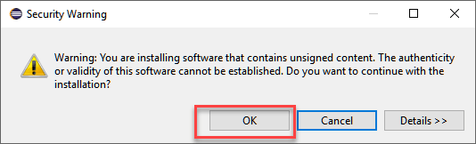
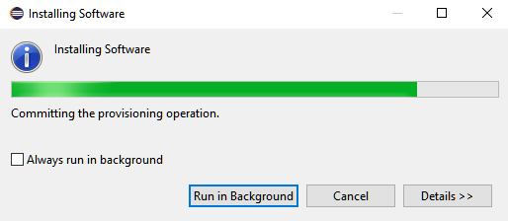
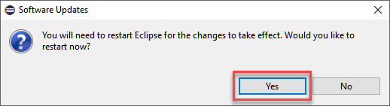
TestNG – Installation

Slide 22
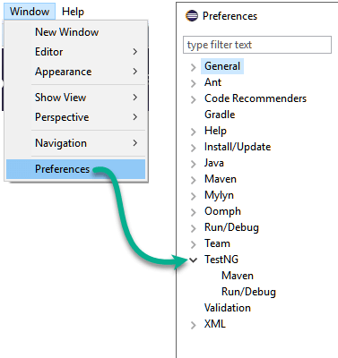
TestNG – Installation
After the restart, verify if TestNG was indeed successfully installed. Click Window > Preferences and see if TestNG is included on the Preferences list.

Slide 23
Locators continues
Locator is a command that tells Selenium IDE which GUI elements ( say Text Box, Buttons, Check Boxes etc) its needs to operate on. Identification of correct GUI elements is a prerequisite to creating an automation script. But accurate identification of GUI elements is more difficult than it sounds. Sometimes, you end up working with incorrect GUI elements or no elements at all! Hence, Selenium provides a number of Locators to precisely locate a GUI element
There are commands that do not need a locator (such as the "open" command). However, most of them do need Locators.
The different types of Locators in Selenium IDE
ID
Name
Link Text
CSS Selector
Tag and ID
Tag and class
Tag and attribute
Tag, class, and attribute
Inner text
DOM (Document Object Model)
getElementById
getElementsByName
dom:name
dom: index
XPath

Slide 24
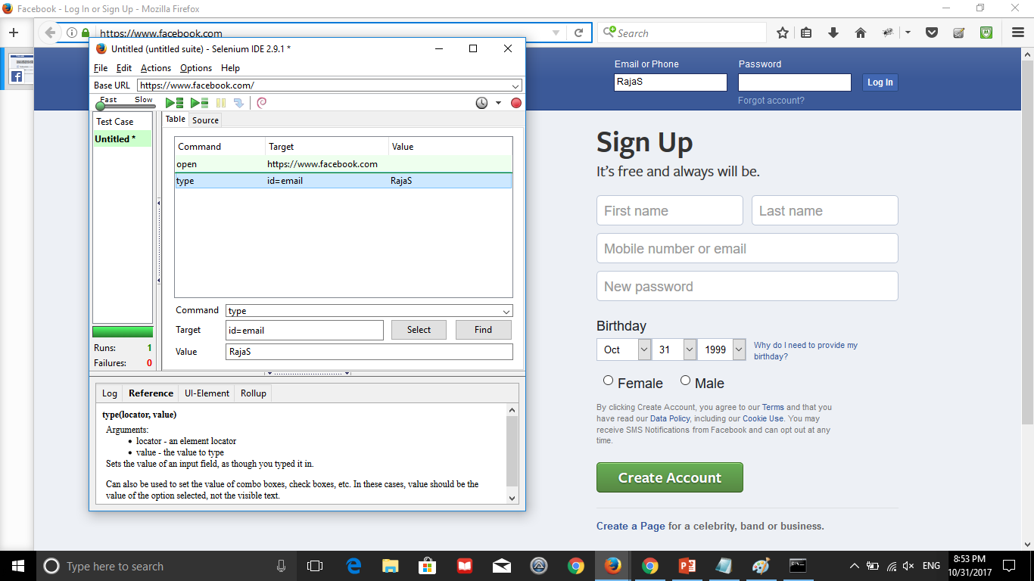
Locators Id :

Slide 25
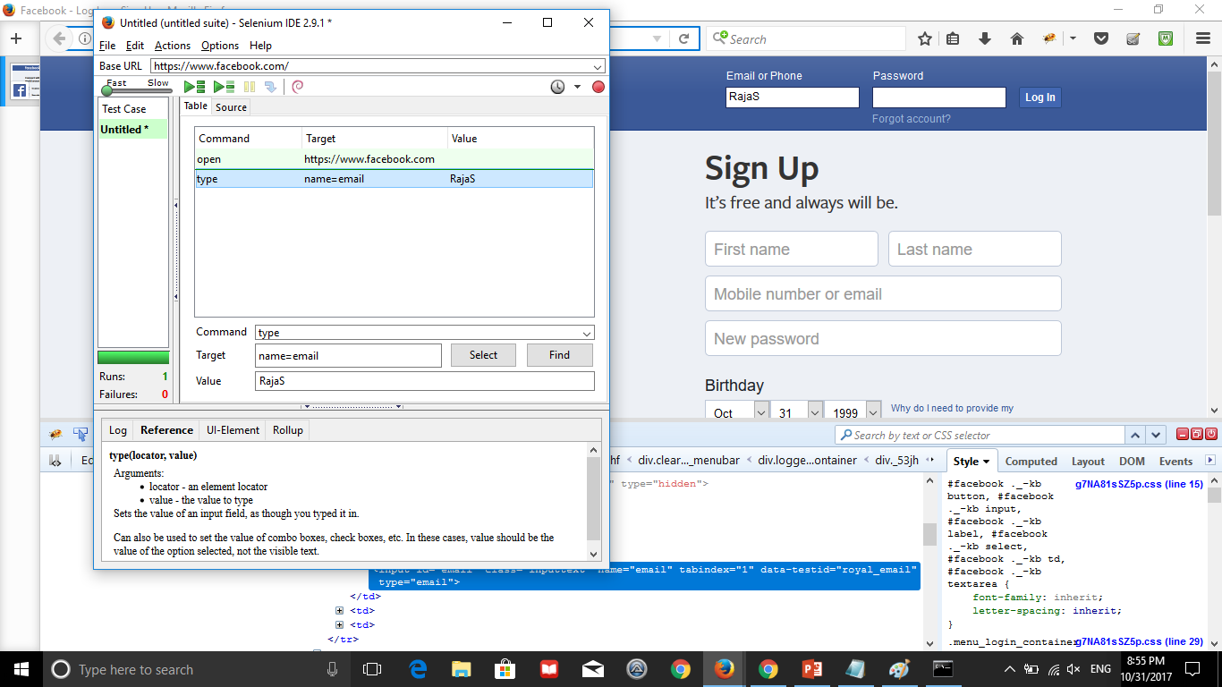
Locators Name :

Slide 26
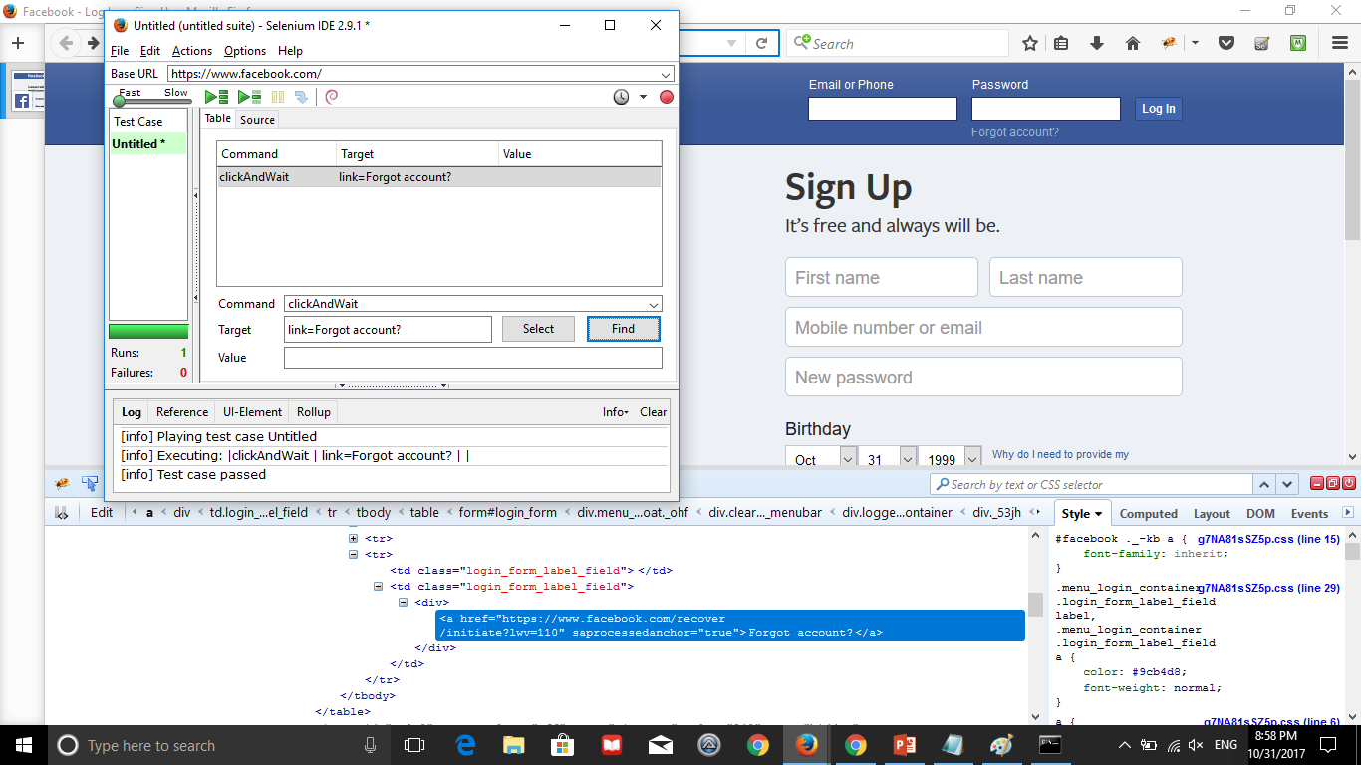
Locators Link Text :

Slide 27
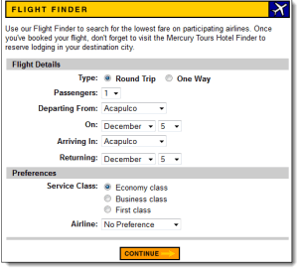
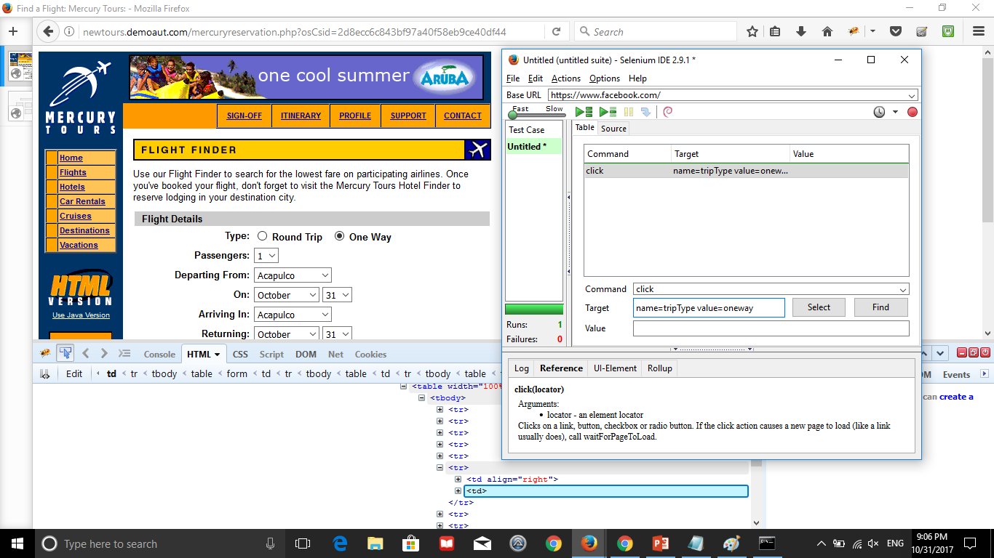
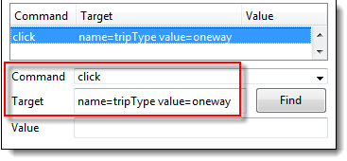
Locators
Locating by Name using Filters
Filters can be used when multiple elements have the same name. Filters are additional attributes used to distinguish elements with the same name.
Target Format: name=name_of_the_element filter=value_of_filter
Launch Browser with URL : http://newtours.demoaut.com/mercurysignon.php
(tutorial is the username & password)

Slide 28
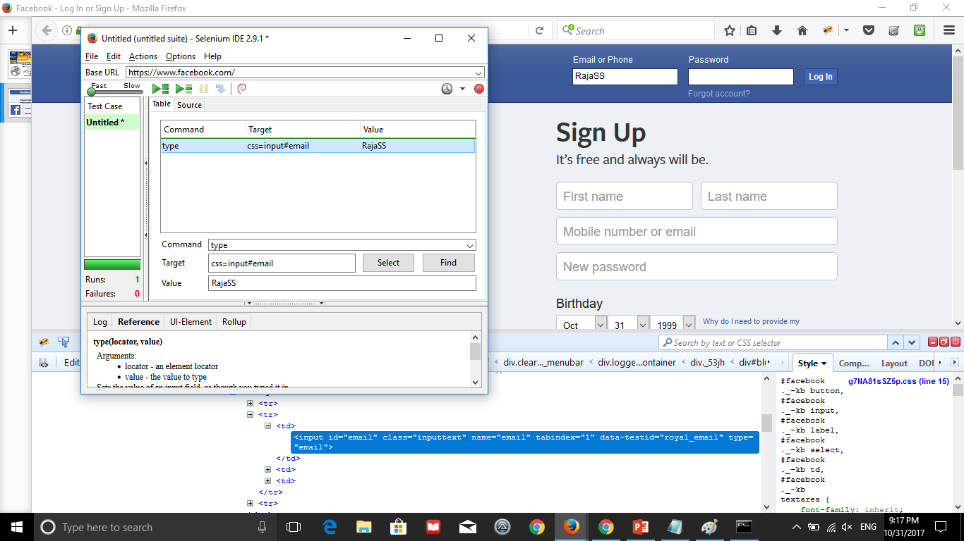
Locators
Locate using CSS
CSS Selectors are string patterns used to identify an element based on a combination of HTML tag, id, class, and attributes. Locating by CSS Selector is more complicated than the previous methods, but it is the most common locating strategy of advanced Selenium users because it can access even those elements that have no ID or name.
CSS Selectors have many formats, but we will only focus on the most common ones.
Tag and ID
Tag and class
Tag and attribute
Tag, class, and attribute
Inner text
css=tag#id | tag = the HTML tag of the element being accessed # = the hash sign. This should always be present when using a CSS Selector with ID id = the ID of the element being accessed

Slide 29
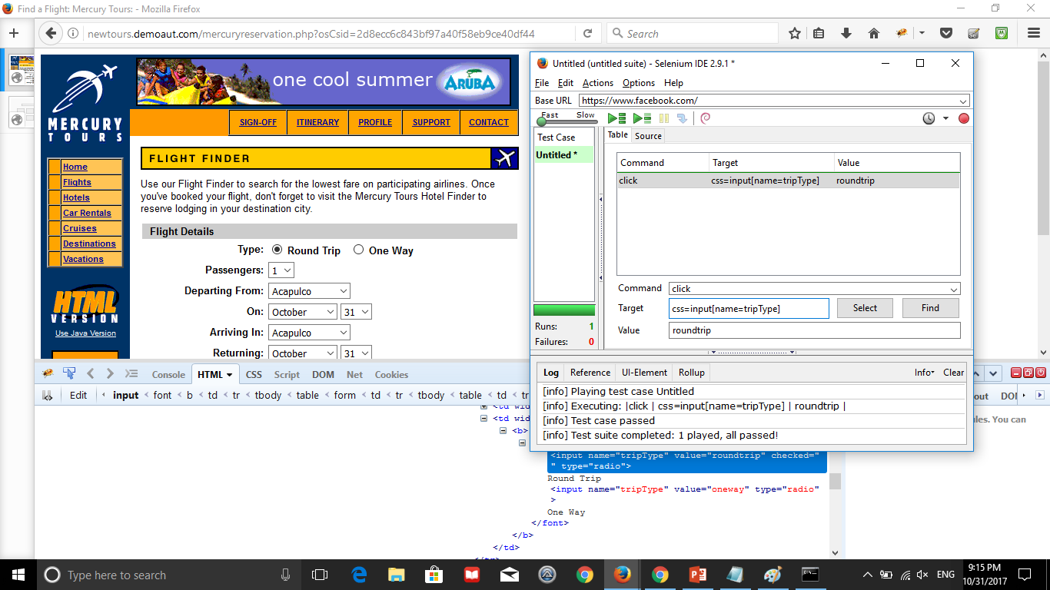
Locators continues..
Locate using CSS
css=tag[attribute=value] | tag = the HTML tag of the element being accessed [ and ] = square brackets within which a specific attribute and its corresponding value will be placed attribute = the attribute to be used. It is advisable to use an attribute that is unique to the element such as a name or ID. value = the corresponding value of the chosen attribute.
Tag and attribute

Slide 30
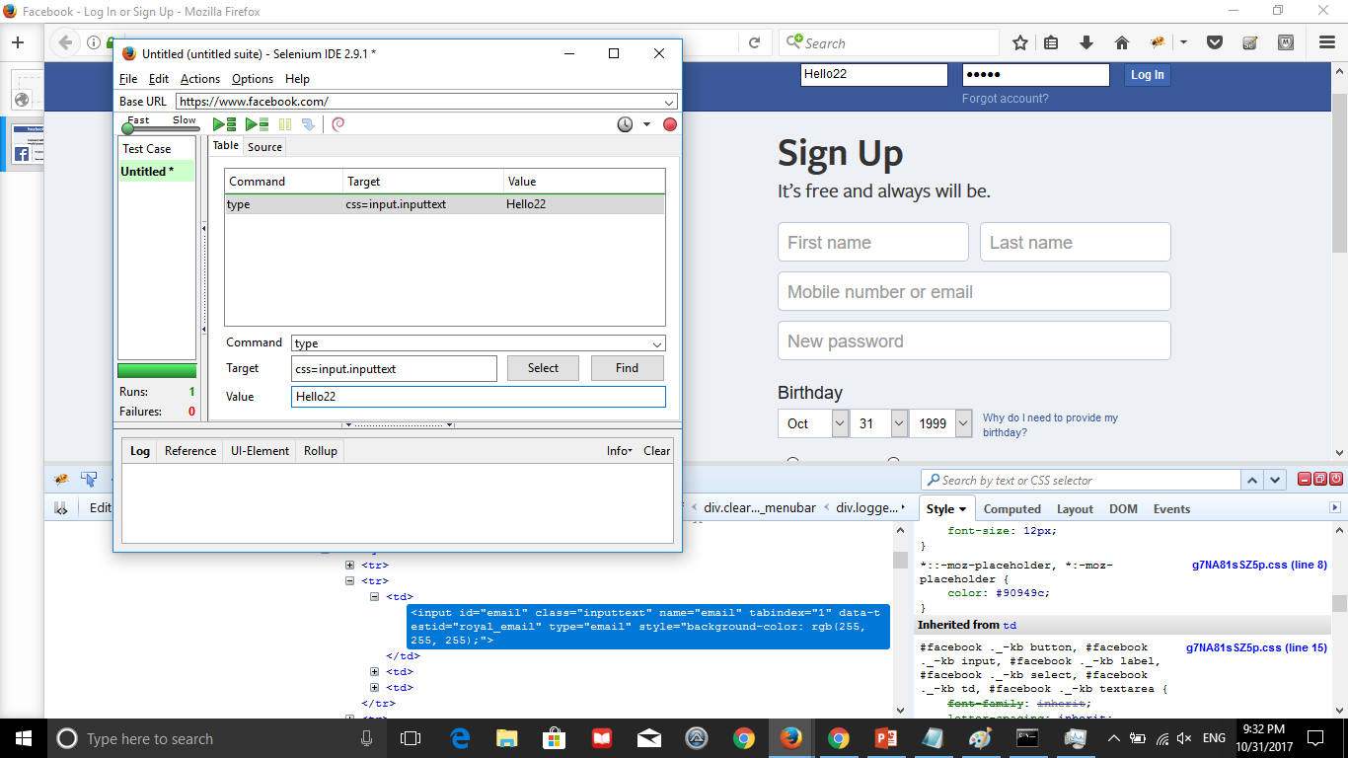
Locators continues..
Locate using CSS
Tag & class
css=tag.class | tag = the HTML tag of the element being accessed . = the dot sign. This should always be present when using a CSS Selector with class class = the class of the element being accessed

Slide 31
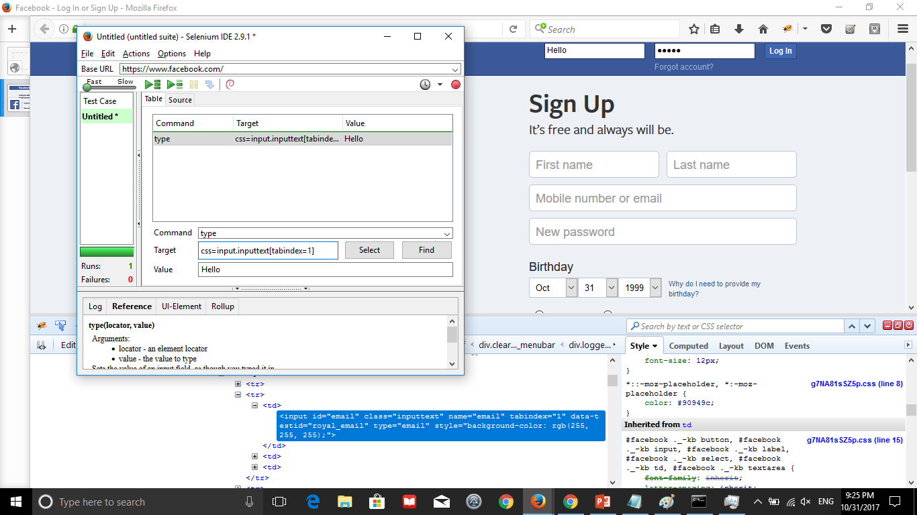
Locators
Locate using CSS
Tag ,class & attribute
css=tag[attribute=value] | tag = the HTML tag of the element being accessed [ and ] = square brackets within which a specific attribute and its corresponding value will be placed attribute = the attribute to be used. It is advisable to use an attribute that is unique to the element such as a name or ID. value = the corresponding value of the chosen attribute.

Slide 32
Locators
Locating by CSS Selector - inner text
css=tag:contains("inner text") | tag = the HTML tag of the element being accessed inner text = the inner text of the element

